Slide 1
Introduction to Data Mining

Slide 2
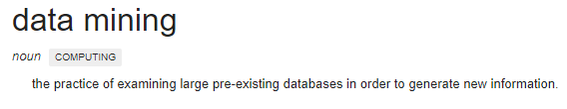

History of Data Mining by Ray Li

Slide 3
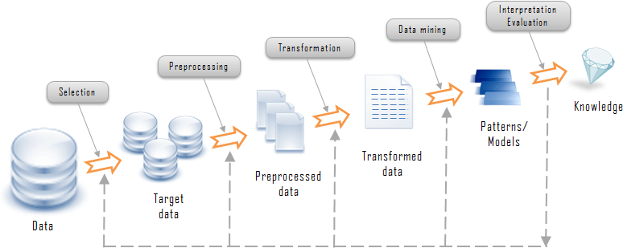
Where Does Data Mining Fit?
Source: Open Source Data Mining Programs: A Case Study in R by Fatih Kayaalp and Muhammet Sinan Basarlan

Slide 4
Where is Data Mining Used?
Telecom: Predict customer churn
Retail: Segment customers based on Recency, Frequency and Monetary (RFM) purchases
Credit Cards: Potential customers for new credit card offerings
E-Commerce: Cross-sell and Up-sell promotions
Supermarkets: Loyalty programs, Stocking shelves
Human Resources: Employee retention and ranking
Educational Institutions: Factors influencing student success/failure rate
Customer Relationship Management: Customer acquisition and retention
Crime Agencies and Fraud Detection: Identify fraud detection patterns
Source: https://digitaltransformationpro.com/data-mining-examples/

Slide 5
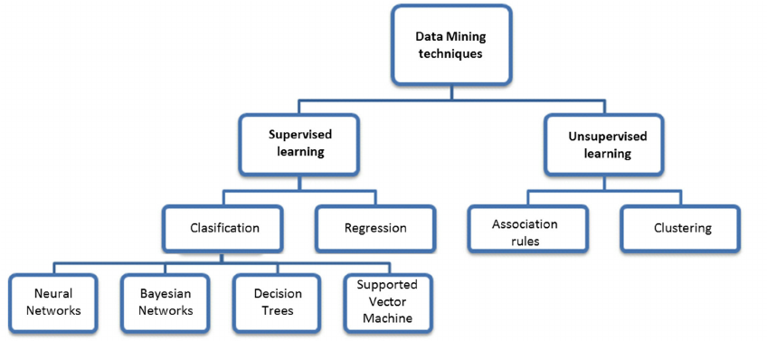
Data Mining Techniques
Source: Using Data Mining Techniques to Road Safety Improvement in Spanish Roads – Published on Research Gate

Slide 6
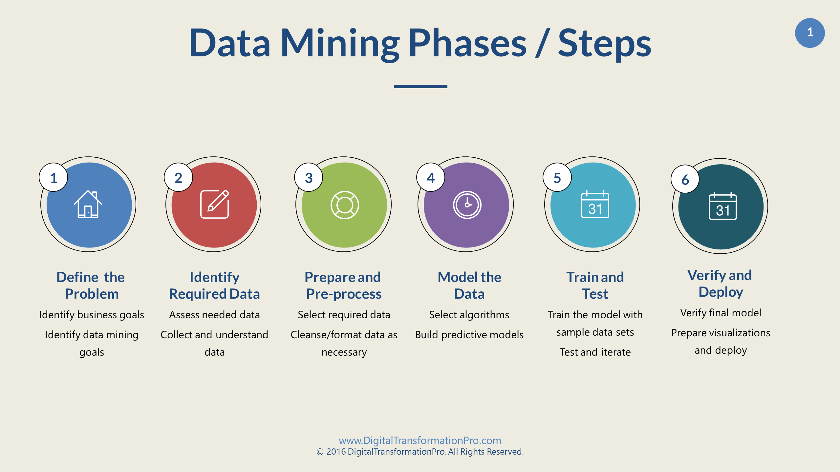

Slide 7
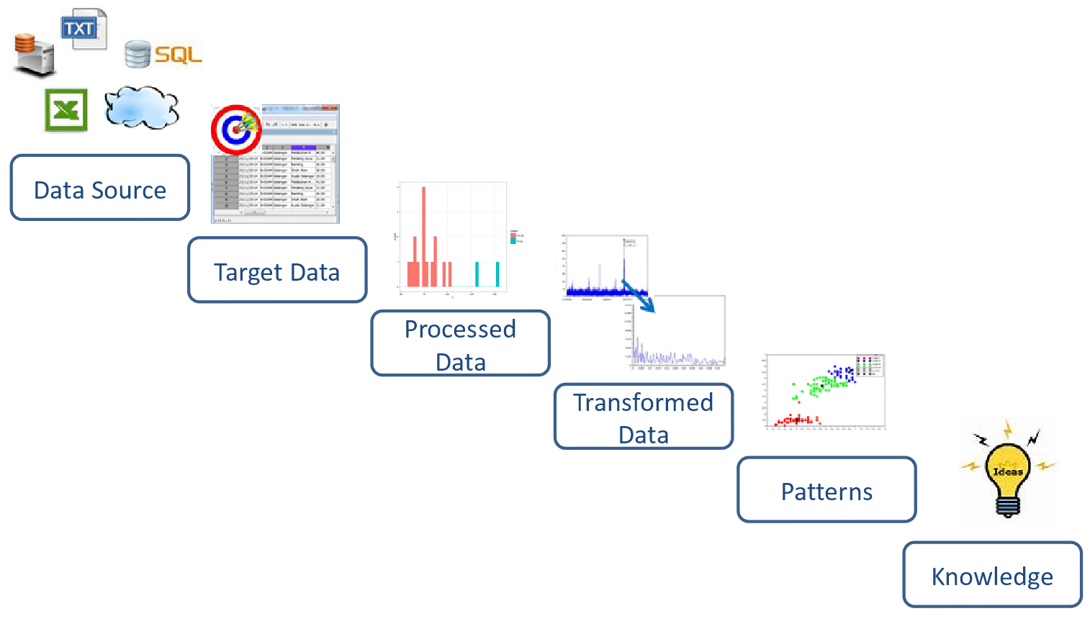

Slide 8
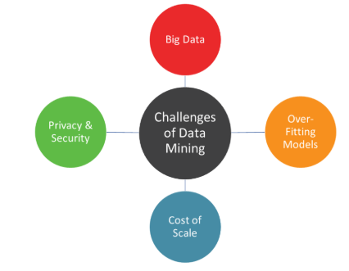
Challenges of Data Mining
Source: Data Mining Explained by Microstrategy

Slide 9
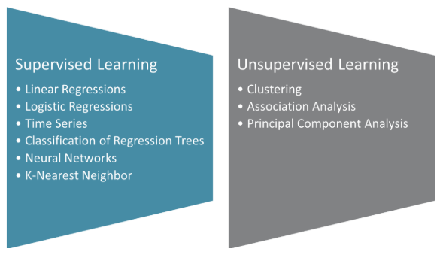
Types of Data Mining

Slide 10
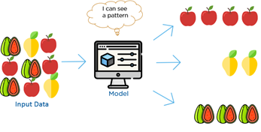

Unsupervised Learning

Slide 11
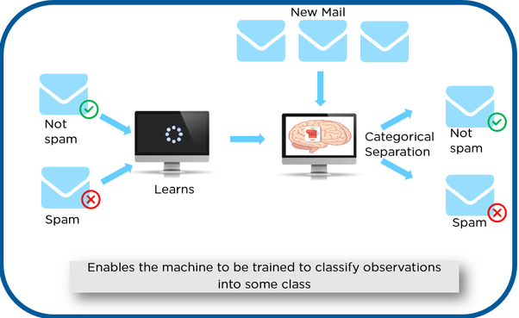
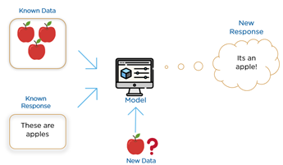
Supervised Learning

Slide 12
Unsupervised Vs Supervised Learning
Unsupervised Learning
No Labels provided
Uses Feature Extraction
Color
Shape
Size
Similarities/Dissimilarities
Creates Groups/Clusters
Requires wide variety of training data
Supervised Learning
Labels provided
Tries to match new data with pre-defined groups based on features
Two Main types of Supervised Learning
Classification
Regression

Slide 13
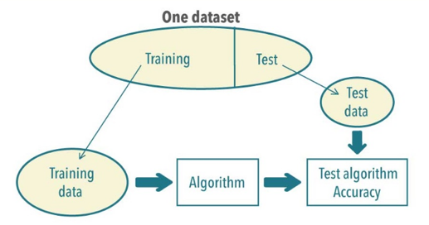
Training and Test Data

Slide 14
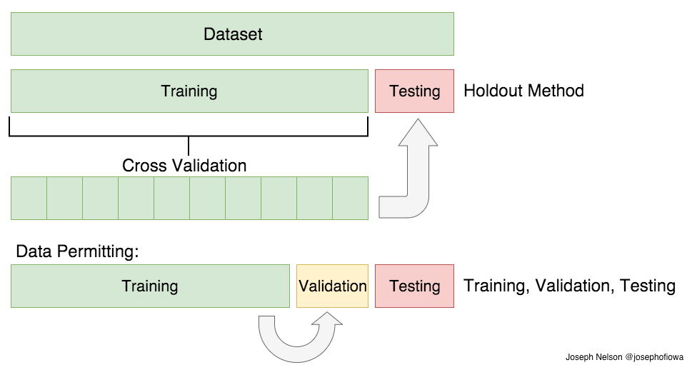
Cross Validation

Slide 15
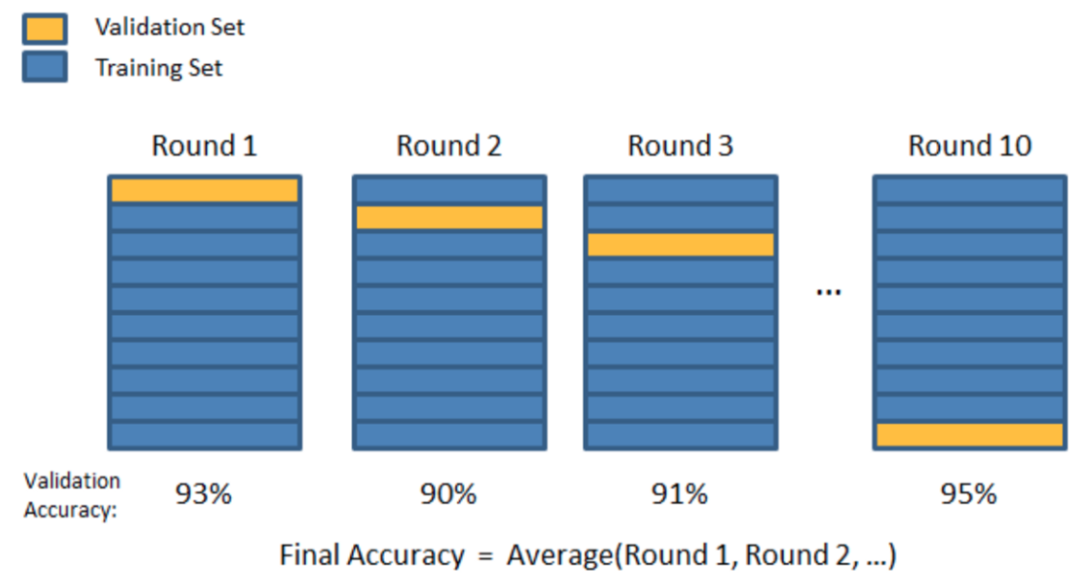
K-Fold Cross Validation

Slide 16
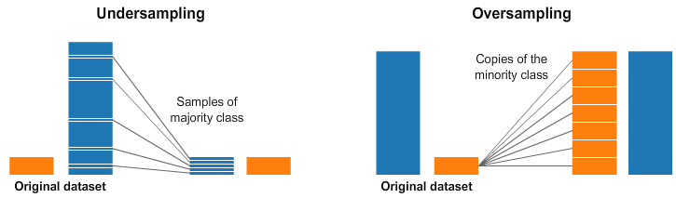
Under Sampling + Over Sampling

Slide 17
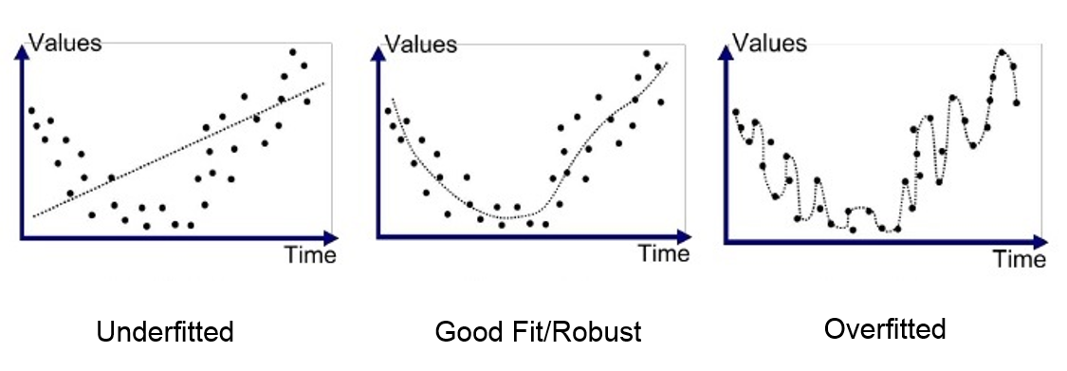
Under/Over Fitting in Regression

Slide 18
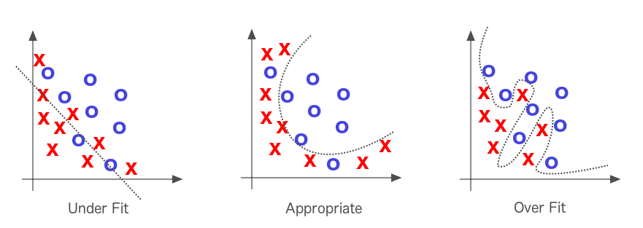
Under/Over Fitting in Classification

